Slide 1
Race Orientation Meeting
April 11th, 2023
CLRA Competitive Team
Regatta Introduction and Logistics

Slide 2
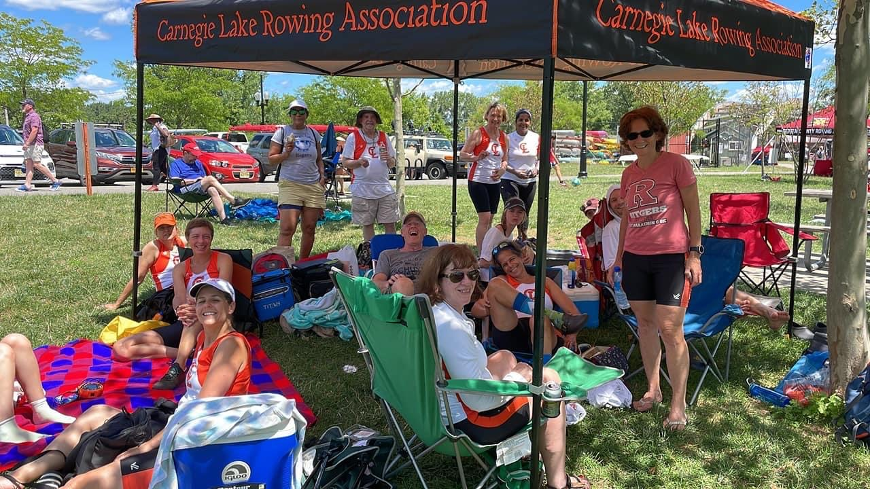
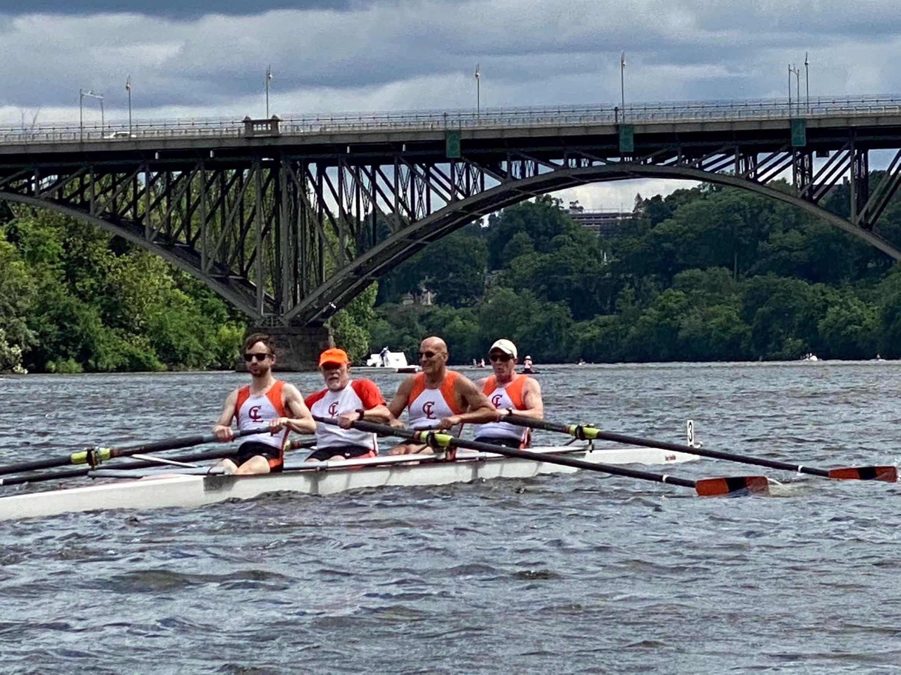
Introduction
Racing with CLRA is open to everyone
Some members race for fun, the experience, and spending the day out with friends
Some members (competitive team) race to win and want to build fitness and skills to increase boat speed.

Slide 3
CLRA Competitive Team
Make space for CLRA club members who want to train with intention to improve fitness and skills
51 of 63 members polled are interested in participating in a ‘competitive program’ with additional workouts, higher intensity training, and improved fitness and skills with the goal of winning races.
Build up the racing program by creating the base for a clear and transparent boating process based on fitness, on the water skills, and attendance
Maximize inclusivity to club members of all levels, including LTR 2022

Slide 4
Commitment Expectations (2023)
To be a “competitive team member” you must:
Complete one erg workout a week (as determined by the coach) and submit your scores to be used for team ranking.
Attend on the water practices
To be a “competitive team member” you should:
Attend at least 2 of 3 morning practices (MWF)

Slide 5
Timed Workouts and Ranking Submissions
Each Sunday the timed erg workout for the week is sent to the competitive members (all do the same workout)
Data must be submitted by Saturday
Submit data to a shared spreadsheet
Our coaches have visibility of the data/ Can use data to rank rowers
Selected erg workout is either the Tuesday or Thursday workout, so members can meet and do it together if they want. Members can also complete the workout on their own time wherever

Slide 6
Seat Racing
To account for on the water skills, seat racing may be used for ranking.
Seat racing is a standard process in competitive youth/ college programs but difficult to perform within CLRA.
Seat racing may be used for the most competitive regattas.
Coaches will determine who should be seat raced based on erg scores and on-the-water observations

Slide 7
Boatings for practices
Competitive team members will be boated together when appropriate
Focus for boatings depends on coach discretion (erg rank, on the water evaluation, attendance, testing lineups and pairings, working on skills, etc.)

Slide 8
Lineups for Races
Rank is the primary consideration, so competitive members already have some idea (and hopefully practice time with) what the race lineup will be
Age, and other considerations, are a factor depending on who signs up for the race (coaches’ discretion)
Always looking to make the most competitive boats
Boating decisions are made by coaches based on whatever criteria or process they decide is best for each circumstance

Slide 9
Recreational Rowers
Practice boatings
Dependent on signup numbers. Coaches will continue to optimize boatings to give everyone a good experience and continue to improve their skills.
Race Lineups
Focus will be to make the most competitive boats first
Opportunity to race for recreational rowers will depend on number of members signing up. Mixed 8 (at least 4 women) can be quite a bit of fun!

Slide 10
Next steps- Competitive process
Erg Google Sheet will be shared with all members
First workout due by 4/22
Active “competitive” boatings starting the week of 4/24

Slide 11
Regattas for Master Rowers (> 21 yrs old)
Spring / Summer regattas (SPRINT races)
1000m races (parallel/ competing side by side)- Floating or Stakeboat Start
June-July
Fall regattas (HEAD races)
~ 4000-5000m (serial, staggered start)
Aug-Nov
All regattas are local (NJ, PA, DE, CT, DC, NY) except Canadian Henley (St Catharines, ON), Masters Nationals (Indianapolis, IN) and Head of the Charles (Boston, MA)
All rowers need to be US Rowing members ($ 25), have a signed waiver (US rowing website) and have a CLRA uniform
Novice rowers: rowers who have never rowed in a race. You remain a novice through 2 seasons (Sprint and Head). A few regattas have novice events but novice can also race with experienced members.

Slide 12
How to sign up for races?
All regattas are open for registration in Wild Apricot. Closing date for all regattas is about 1 month before the regatta
Racers should generally be available 2 weeks before the race. (2-5 practices/ week depending on boatings/ events/ season)
Racers need to be available the entire race day
Preferred side to row
Age (as of the end of current calendar year). Avg age of boat used (excl cox).
Lightweight (Men < 160 lbs, Women < 130 lbs)
Comments: availability issue, sculling partner, etc.

Slide 13
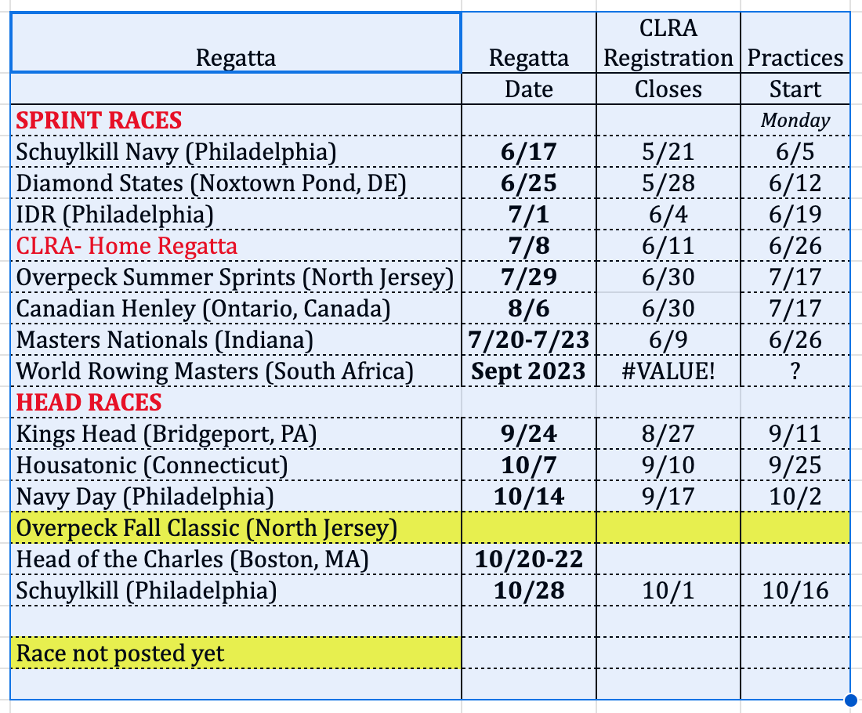
Regatta Schedule (Regatta Central)

Slide 14
Cost of racing
Rowers participating in the regatta share all costs, including registration and equipment rental (fuel, truck for trailer / boats as needed).
Race practices cost the same as “regular” practices
For local regattas the range is ~ $ 40-150/ rower
For distant/ multi-day regattas, the cost may be significantly more (additional travel/ lodging expenses)

Slide 15
Boatings (Coaches)
Provide an opportunity for rowers to row in boats that match their skill and interest levels (competitive vs. recreational)
Maximize the chances of placing in a race
Selection procedures include 1) assessing sign ups, 2) erg test/result/ workout submissions (if applicable) 3) coaches’ on the water evaluation 4) seat racing for specific boat/lineup in the event of close contention for most competitive regattas
Pairs/ Doubles manage their own partners
HOCR and Masters Nationals- unique regattas
Coach makes priority lineups (best potential to qualify / medal)
Please do not go directly to coaches if you have an issue with the boat you’re in, reach out to the Race or Club captain!

Slide 16
Practices / Boat Captains
About 3 weeks before race day, boatings, boat captains, and practice schedule will be communicated. (Race practices are managed outside of “regular” wild apricot signups)
If you cannot make a practice, it is your responsibility to find a sub and notify your boat captain
Boat captain’s responsibilities:
Secure practice coxswains
Communicate with rowers and confirm attendance to all practices
Confirm that all rowers have a ride to regatta
Confirm attendance at loading, unloading, de-rig/rigging, and in charge of rounding up rowers before hands-on at regatta
Be the “voice” and manage all communications with the race captain (boat issues, logistic info, etc)

Slide 17
Dropouts
We really encourage everyone to stay committed up to race day. If you have an emergency and must drop out of the race after the boats are made, notify the race captain. A last minute drop out has a big impact on the team and the race captain... Typically line-ups are submitted, boats registered, etc.
If you must, also please work out cost of practices and regatta with the substitute you identify. Without some type of agreement, the practices are all paid by the original rower and the regatta costs shared 50/50

Slide 18
Trailer Management
Truck rental
Safe and efficient loading/ unloading of the trailer
Drive to regattas
Trailer loading / unloading
Friday before race- boats are derigged and prepared for trailer (secure seats, check heel ties, wing nuts, loose equipment tied)- may last to 7:30-8
Friday boat loading
Stow all riggers, oars, etc.
Need new drivers! Free training and it’s fun!

Slide 19
Race Uniforms (Denise Dwyer)
All rowers must wear CLRA racing uniforms to race
We typically order uniforms once a year at a discount

Slide 20
Race Camp- May 8-13 2023
Focused on training race skills
5 days weekdays 5:30-7, Saturday Race
No regular practices this week
Cost of sessions same as “regular” practices
Program developed by Coach Emma
Everyone is encouraged to attend!

Slide 21
General race day- Things you need to know
Racing is a lot of fun!
You need to be at the regatta site 2 hours before your race time, but really two hours before the first race of the day to help with unloading and re-rigging, and cheering on your teammates!
Factor in travel, parking and walking to the site
Hydrate well, bring a hat, sunglasses, and digestible food (to share :) )
Bring your uniform
Bring extra layers
Bring a camp chair, blankets, cooler
Meet with your cox pre-race to discuss strategy / calls. The cox is in charge. Follow all instructions :)

Slide 22
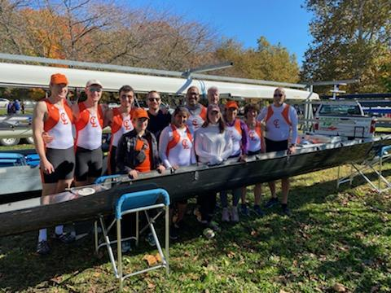
Questions / Comments?
The Competitive Committee Team:
Genevieve Looby
Doug Braun
Jeanne Perantoni
Courtney Coffman
Samuel Seward
Ed Wengryn
Elisabeth Hauptman

Slide 23
Masters Nationals - Indianapolis, IN- July 20-23
Highly competitive regattas. The coaches determine who is qualified
4 days
Travel and accommodation on your own
Multiple 1000m races in a day. Not everyone is guaranteed the same number of races.
Self-organization / coordination between rowers at the site (not managed directly by club)
Club does not always supply boats/oars so this may fall on participants at the regatta site
Minimum of 4 rowers will be required for the club to actively support rowers (registration, practices) going to the regattas. Rowers/ scullers may choose to participate on their own if there is not enough interest.
Coaches makes priority line ups. Best 8 and 4 in each age category- Best potential for medals

Slide 24
Head of the Charles- Boston Oct 20-22
Highly competitive regatta. The coaches determine who is qualified
Head Race
Process to participate:
Qualified boat from the prior year (sweep events normally coming in the top 50%)
Selected via lottery. Large number of applicants—> lower odds of getting a boat. Limited number of boats / seats. Crews will be selected by coaches who have the greatest chance of qualifying
Signups to go out this summer (probably in June)
Scullers and Director’s challenge (charity) typical deadline late July / early August
Sweep rowers typical deadlines late August
Lottery submission
Boating- Will likely include erg tests and seat racing per coach’s discretion

